Slide 1
Basic HTML and CSS
Origin Code Academy
Notes:
We are going to recap what you learned from the work you were asked to complete before taking the course.

Slide 2
What is HTML?
HTML stands for HyperText Markup Language
HTML is not a programming language.
HTML is the standard markup language used to create web pages.
Web browsers read HTML files and render them into something the user can see or hear.
Notes:
(Read points on screen)
HTML is useful in many different situations, it’s not just for websites. People also use it to build mobile applications.

Slide 3

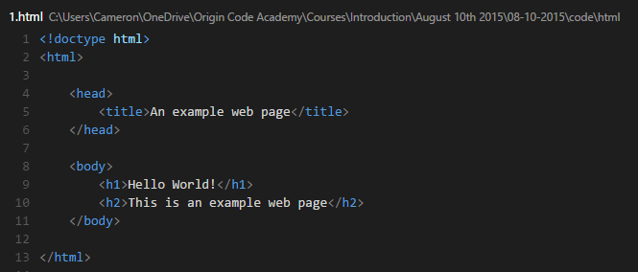

An example HTML file
Notes:
Here’s an example HTML file. I expect you should be familiar with this example – but if you’re not, every html file starts with a document type declaration. This lets editors like the one I’ve shown here (Visual Studio Code) help us validate our HTML code to certain standards – in this case HTML5.
First, we declare our html document by using an open HTML tag on line 2, followed by a close HTML tag on line 13.
Next, we declare our head element which holds metadata about our page, like the title that should be displayed in the browser.
Next, we declare our body element, which will contain the content that we want to display in the browser window.
We have two elements here – a h1 element saying Hello World! In big bold letters, followed by a h2 element saying “This is an example web page”.

Slide 4
HTML Elements
HTML elements usually have an opening tag, and a closing tag, with content sandwiched between them.
<h1> Headline using h1 </h1>
<h2> Smaller headline using h2 </h2>
<h3> Smaller headline still, using h3 </h3>
<p> Inform using a paragraph element </p>
Notes:
(Read the screen)
Highlight the importance of having an opening and closing tag.
“In most cases there should be a closing tag for every opening tag. There are some exceptions to this rule, we’ll get to that in a minute.”

Slide 5
HTML Elements
There are many HTML elements, here are a few common ones
You can find a full list at http://www.w3schools.com/tags/
Element Name | Open | Close
Heading 1 | <h1> | </h1>
Paragraph | <p> | </p>
Hyperlink | <a> | </a>
HTML | <html> | </html>
Head | <head> | </head>
Title | <title> | </title>
Notes:
(Read the screen)
(Point to w3schools for full list of tags)
Use the full list as a reference rather than trying to learn them all at once. Work smart, not hard.

Slide 6
Attributes
HTML elements often include some attributes too.
Attributes change the way a HTML element works.
An example of a HTML elements that use attributes is the <a> element used for hyperlinks.
<a href=“http://www.origincodeacademy.com”> Click here to go to Origin Code Academy </a>
For reference, here is a list of html elements and their relevant attributes. https://simon.html5.org/html-elements
Notes:
(Read the screen)
The a element creates a hyperlink on the page, which when clicked will tell the browser to redirect the user to the URL contained inside the href attribute. In this case, when this a element is clicked, the browser will redirect us to http://www.origincodeacademy.com.
For every HTML element, there is more than likely one or more attributes that can be used with that element. Again, use this as a reference, don’t try to memorize this all at once.

Slide 7
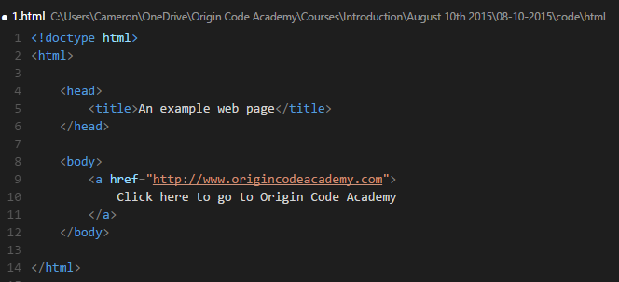

Attributes
Notes:
Here’s our example from the previous slide shown in our code editor, and in the web browser.

Slide 8

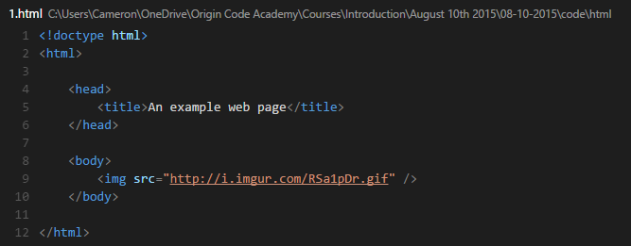

Attributes
Another example of an element that includes attributes is the <img> element.
The img tag is one of the HTML elements that doesn’t require a closing tag.
Notes:
Another example is the img tag.
It’s worth mentioning here that img tags are one of the special HTML elements that do not require a closing tag. This is because typically nothing is contained inside of an img element, the attributes defined in an img element are sufficient for the browser.
It’s an HTML oddity for sure, it’s really just a shorthand to reduce the amount of HTML you need to write.
The img element tells the browser to display an image on the screen. The browser looks for a URL in the src attribute. In this case, we tell the browser to load this Garfield picture from imgur.

Slide 9
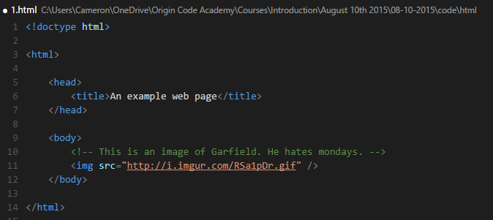
Comments
Comments are not displayed in the web browser, and are mostly for the developers benefit.
An example of a comment on Line 10
Notes:
Comments are pieces of text that do not show in the browser, but are visible in the source code.
Anything between the opening <!-- and closing --> is a comment.

Slide 10
Review
Q: What is the first thing we need to specify in a HTML file?
A: Document Type Declaration <!doctype html>
Q: What does HTML stand for?
A: HyperText Markup Language
Q: Which attribute is used to tell the browser where to find an image?
A: The src attribute

Slide 11
Styling HTML Elements
Any HTML element that is visible on a page can be styled.
Styling changes the appearance of an HTML element.
This can be done by adding a style attribute on any element.
Notes:
Next, let’s recap how HTML elements are styled, without using CSS.

Slide 12
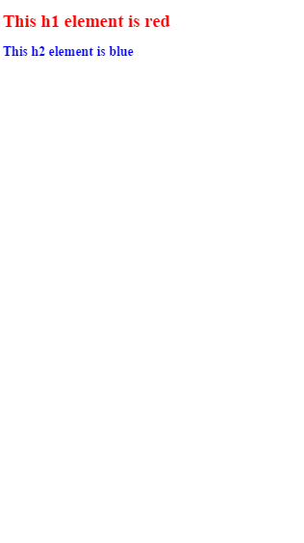
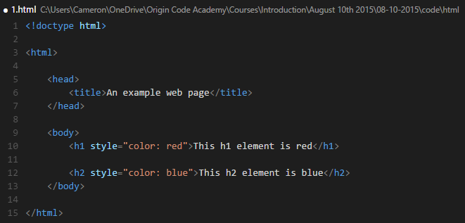
Styling HTML Elements
In this example, we specify the color of the h1 and h2 elements by adding a style attribute to each one.

Slide 13
Styling HTML Elements
Adding a style attribute to an element is known as inline styling.
There is a better way – Cascading Style Sheets (CSS).
Notes:
In the previous example, we added a style attribute to our HTML elements. This is known as inline styling.
This is great for styling individual elements, but what if we had 20 h2 elements on a page instead of just the one, and we wanted all of them to be blue? We would have to style each one of them individually to be blue.
Even worse, if we change our mind to make them all red – we would have to go back through each h2 element individually and set them to red.
There is a better way – by using CSS.

Slide 14
Cascading Style Sheets (CSS)
CSS is a styling language that changes how HTML elements are displayed using a set of rules.
A CSS rule consists of a selector and a declaration block.
The selector points to the HTML element you want to style. The declaration block contains one or more declarations separated by semicolons A declaration includes a property name and a value, separated by a colon.
Notes:
CSS is a styling language that changes how HTML elements are displayed on the page by defining a set of rules.
A CSS rule is best described when broken down into it’s individual parts.
In a CSS rule, there is always a selector and a declaration block.
(Read the definitions)

Slide 15
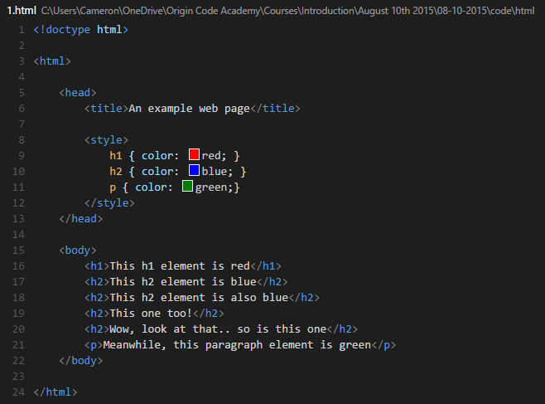
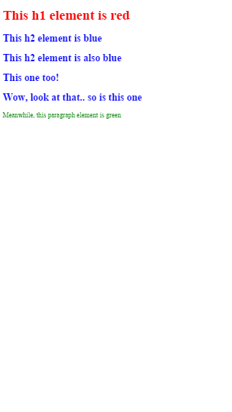
Cascading Style Sheets (CSS)
Notes:
Highlight that we’ve removed our style attribute, and instead added a style element inside of our head element that contains our CSS rules.
Highlight where the selector is in line 9
Highlight where the declaration block is in line 9
Highlight where the property name is in line 9
Highlight where the property value is in line 9
Highlight that although we now have 4 h2 elements, thanks to our CSS rule on line 10, all of our h2 elements are colored blue.

Slide 16
Cascading Style Sheets (CSS)
There are multiple types of selectors
We used an element selector before, which styles every element on the page specified in our rule.
Let’s use a class selector this time. A class is a reusable style that can be added to any HTML element.

Slide 17
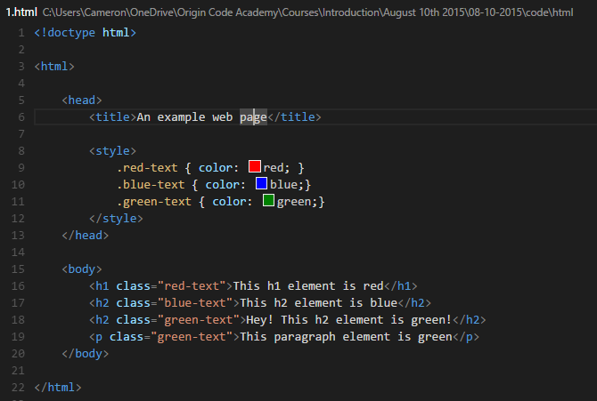
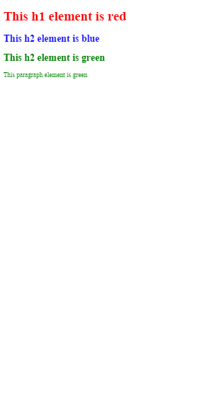
Cascading Style Sheets (CSS)
Notes:
Highlight the three class selectors.
Explain that the dot denotes that this selector is a class selector.
Explain that our declaration block is still the same.
Highlight the new class attribute on the h1, h2 and p elements.
Explain that the class attribute contains our class name, without the period.
Highlight that we have two h2 elements on the page, but instead of always coloring them blue like before, we’ve colored one blue and one green.
Highlight that we can apply classes to multiple elements. We’ve applied our green-text class to both the h2 and the p element.

Slide 18
Cascading Style Sheets (CSS)
CSS classes can be used on multiple elements
This allows you to define a style once, and use it anywhere
But what if we only want to style one specific element? Element selector? Class selector?
To style one specific element, we should use an identification selector
Notes:
(Read the screen)
What if we want to style a specific element, which selector should we use?
Can we use an element selector? – No, because any time we use that element again, it will be styled according to our element selector rule.
Can we use a class selector? – Maybe, but this is not the intended use of a class.

Slide 19
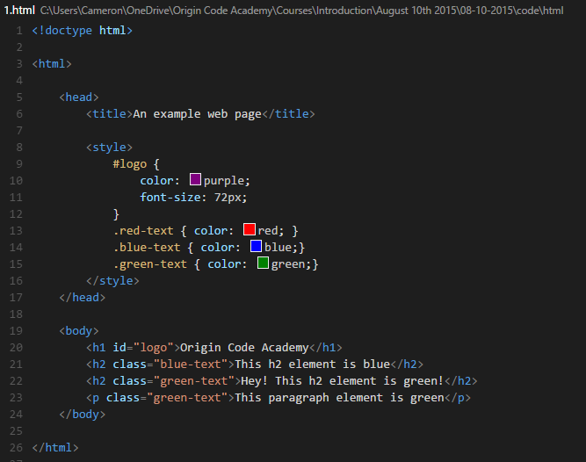

Cascading Style Sheets (CSS)
Notes:
Highlight the new identification selectors.
Explain that the pound key denotes that this selector is an identification selector.
Explain that our declaration block for our logo rule contains two declarations, one for color and one for font-size
Highlight the new id attribute on the h1 element
Explain that the id attribute contains our id name, without the pound sign.
Highlight that id selectors are a great way to style elements that typically only appear once on the page (such as the logo, or a navigation bar)
Highlight that an id is unique to an element. Two elements should not share an id.

Slide 20
Review
Q: What is an inline style?
A: Styling defined in a style attribute of an HTML element
Q: What is an element selector?
A: An element selector styles all instances of that element on a page
Q: How many elements can be styled with an identification selector?
A: One

Slide 21

Workshop – Let’s make our first HTML site!

